Slide 1
The Japanese 5s Technique.
-Presentation to Mr. Ashok Bhandari and class

Slide 2
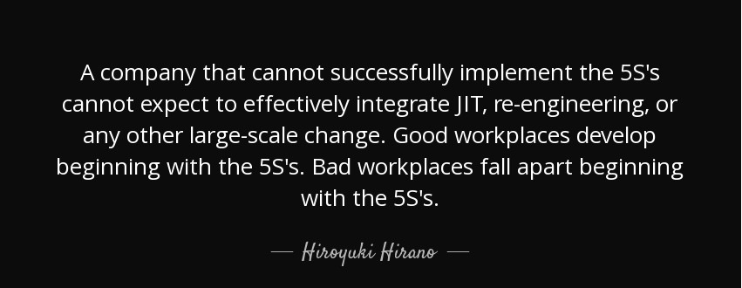
The Japanese 5s Technique:

Slide 3
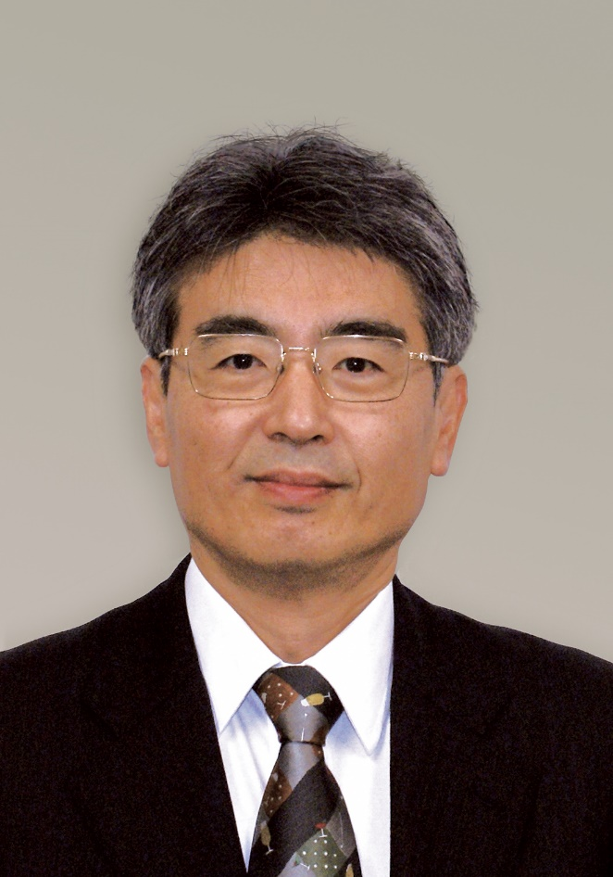
What is 5s Methodology?
Method Borrowed from Japanese.
Method that Organizes the Workplace.
Method that discard the burden in work.

Slide 4
The 5S’s in 5s Technique.
5s
Sort
Set
Sustain
Shine
Seiri
Seiton
Seiso
Seiketsu
Shitsuke
Standardize

Slide 5
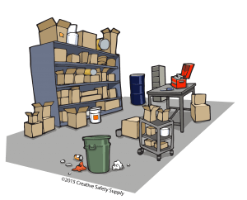
1. Seiri (Sort)
Keeping necessary and removing unnecessary.

Slide 6
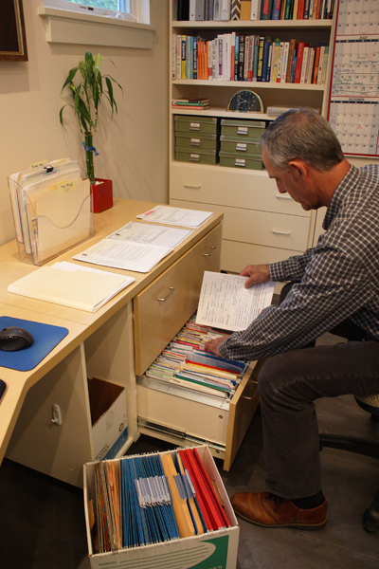
2. Seiton (Set)
Place for Everything and Everything in place.

Slide 7

3.Seiso (Shine)
Cleaning the Working Environment.

Slide 8

4. Seiketsu (Standardize)
Standardize by:
Control
Consistency
Rules
Records (checklists)

Slide 9
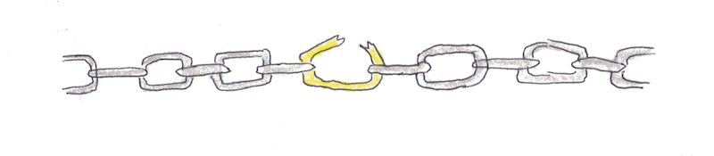
5. Shitsuke (Sustain)
Discipline to not breaking the chain of organizing things.

Slide 10

Why 5s Methodology?
Maximize Productivity.
Eliminates:
Wasted Time
Wasted Space
Wasted inventory
Lower cost and Higher Efficiency.

Slide 11
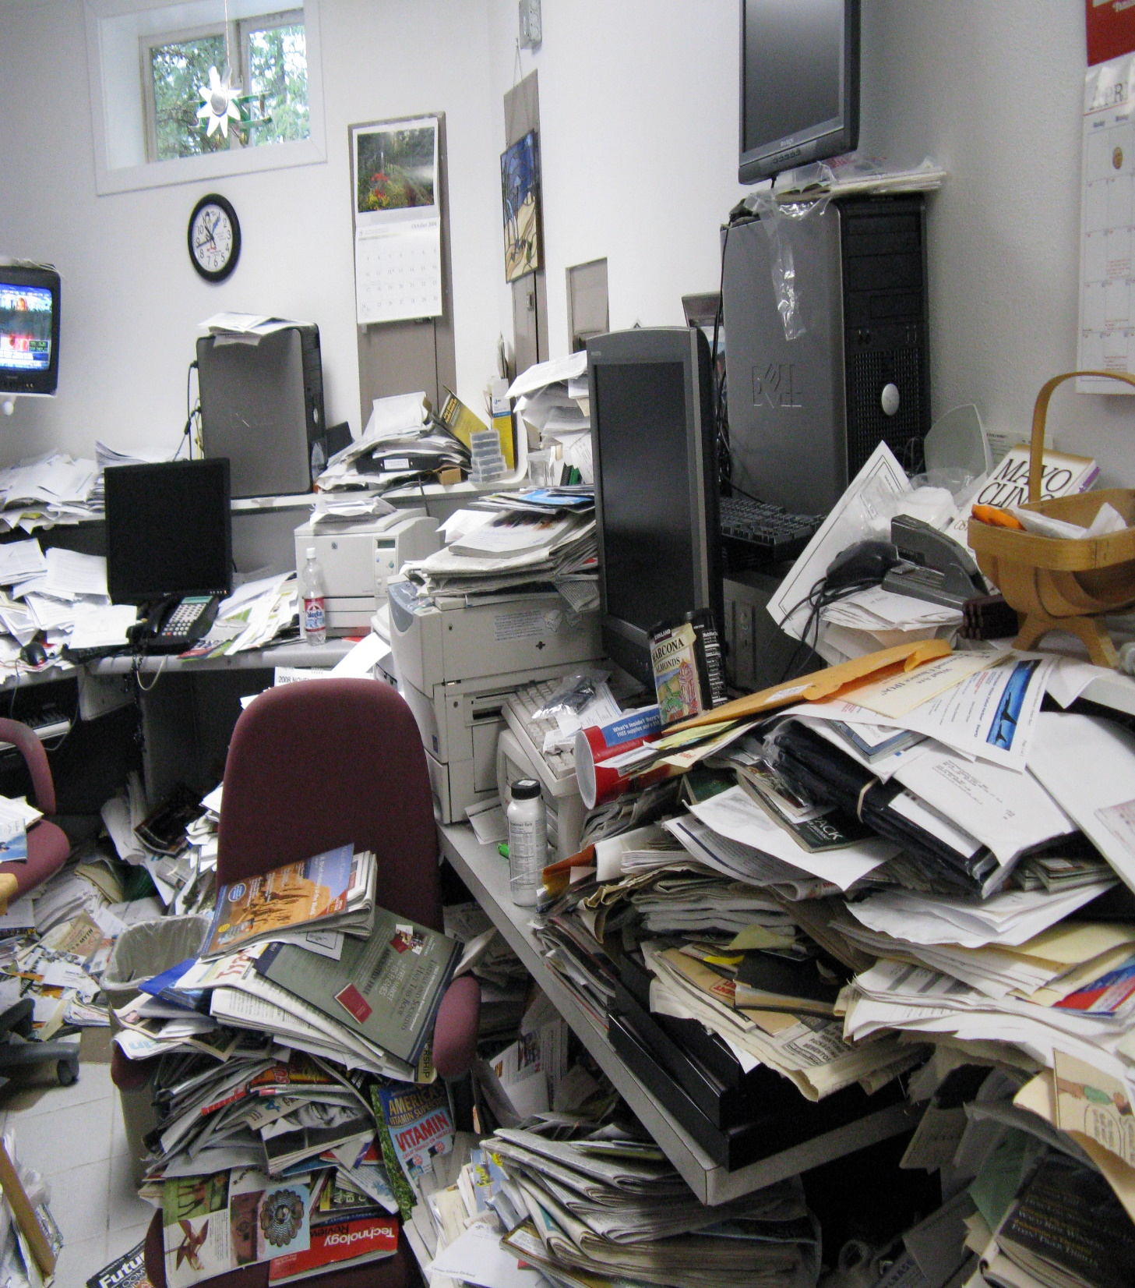

So where do you want to work?
Here or Here

Slide 12
Hope, You Like it.
-By Bishal Phuyal

